Slide 1

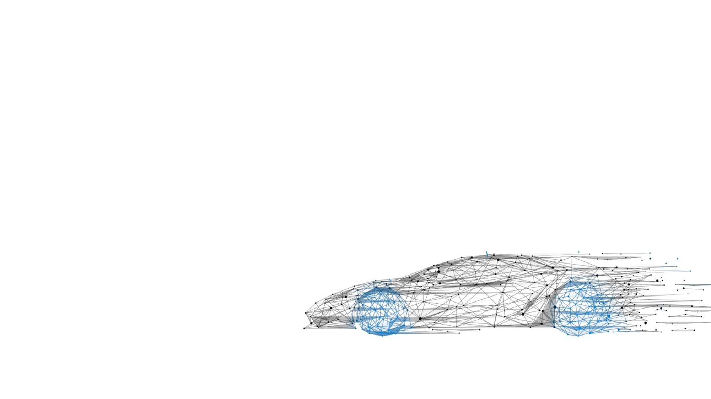
Motor Design Presentation
EV 2W Motor
Enabling Mobility Solutions
1

Slide 2
Contents
Powertrain Sizing and Assumptions
2. Design Parameters and Sensitivity Analysis
3. Design Simulation and Validation
4. Performance Analysis and Validation
5. Conclusion
Enabling Mobility Solutions
Strictly Confidential

Slide 3
Powertrain Requirements
Rated Power = 7.5kW to 9.5kW
Base Speed = 3000 RPM to 4000 RPM
Peak Speed = 5500 to 6000 RPM
Voltage = 72Vdc
Motor Mass = 8kg to 10kg
Cooling = Blown Over Natural Convection via Fins
Vehicle Gross Weight = 300kg (Kerb + 2 Healthy Adults + Payload)
(140+(2*75)+10 kg mass split-up)
Efficiency > 90%
Vehicle Top Speed = 80kmph +
Acceleration (0-60kmph) < 7 secs
Enabling Mobility Solutions
Strictly Confidential
3

Slide 4

Design and Environment Considerations
Number of stator slots = 12
Number of rotor poles = 8
Drive Layout: Horizontally mounted
Rotor: Interior Permanent Magnet
Performance Targets: WLTP Class-I
Stator Laminate Diameter < 150mm
Ambient Temperature = 40 C
Stack Length < 120mm
Operating Temperatures <140 C
Winding Type: Lap Wye Wound
Winding Design: Full Pitch Winding
Overall Efficiency > 90%
Enabling Mobility Solutions
Strictly Confidential
3

Slide 5
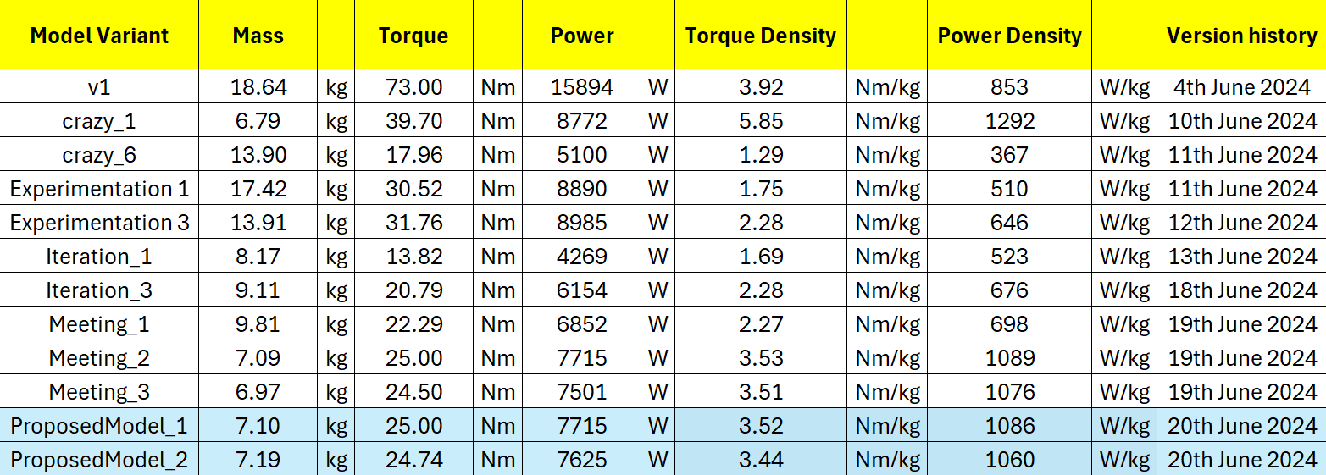
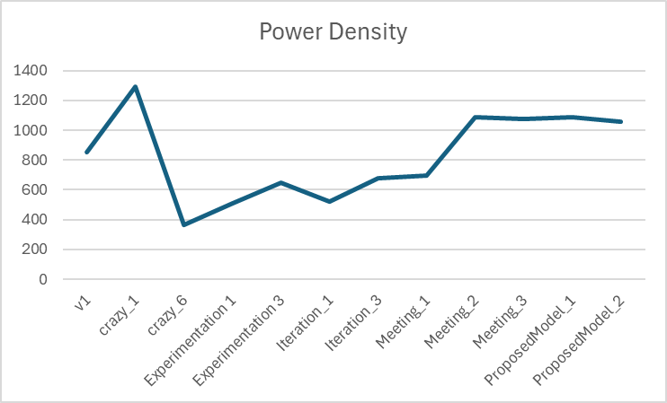


Design Iterations
Enabling Mobility Solutions
Strictly Confidential
3

Slide 6
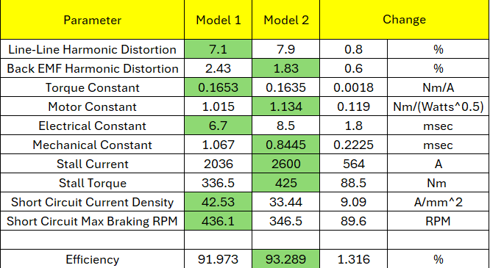
Proposed Model 1 vs Proposed Model 2
Model 1: SWG 19 & 72 conductors/slot
Model 2: SWG 16 & 36 conductors/slot
Enabling Mobility Solutions
Strictly Confidential
3

Slide 7
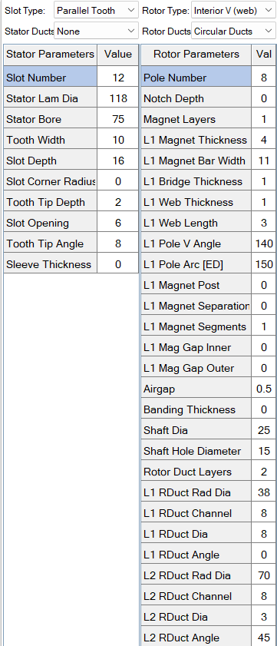
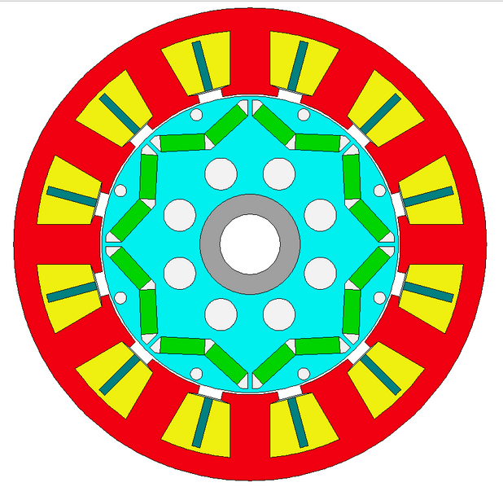
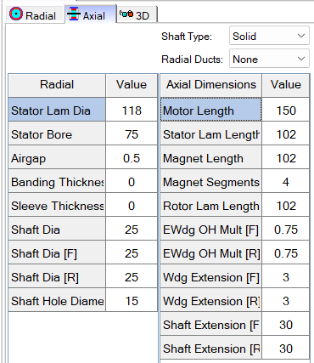
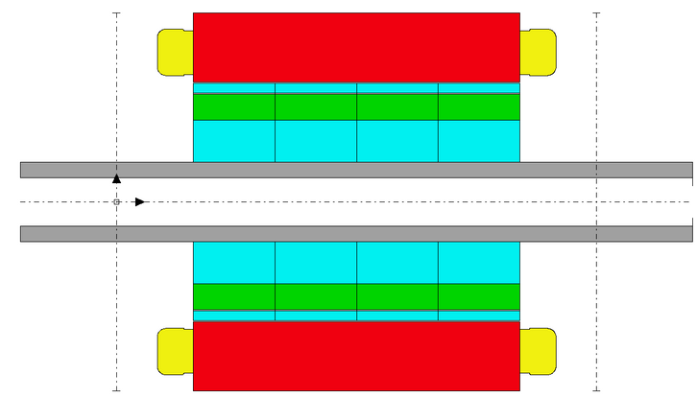
Final Design Parameters
Enabling Mobility Solutions
Strictly Confidential
3

Slide 8
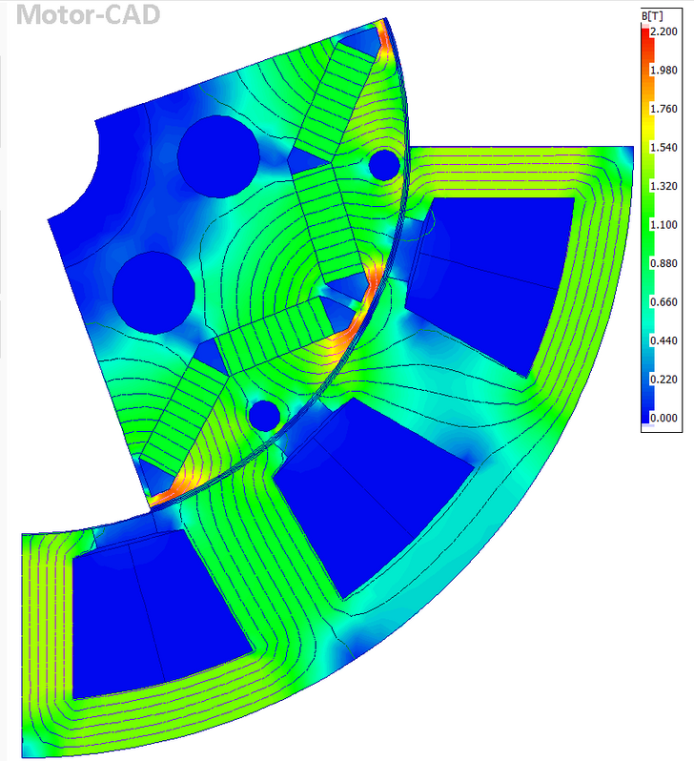
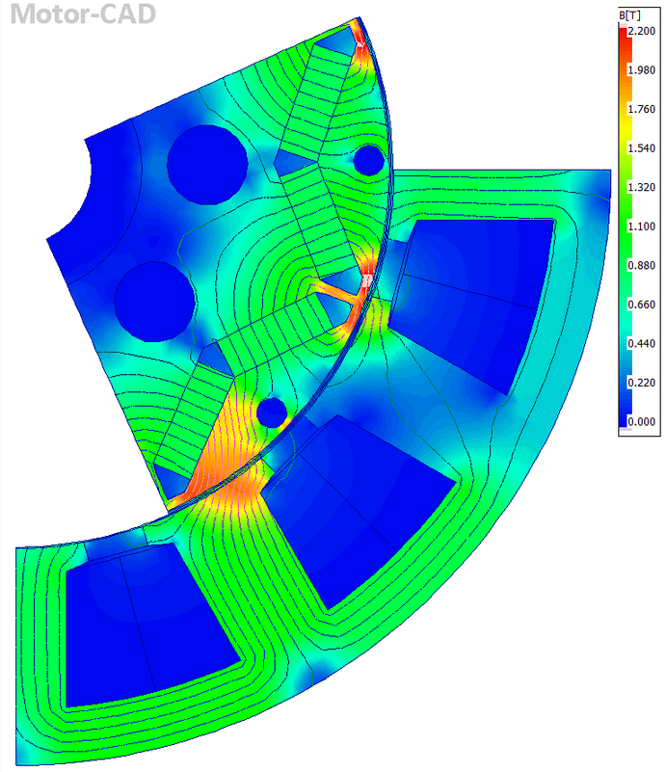
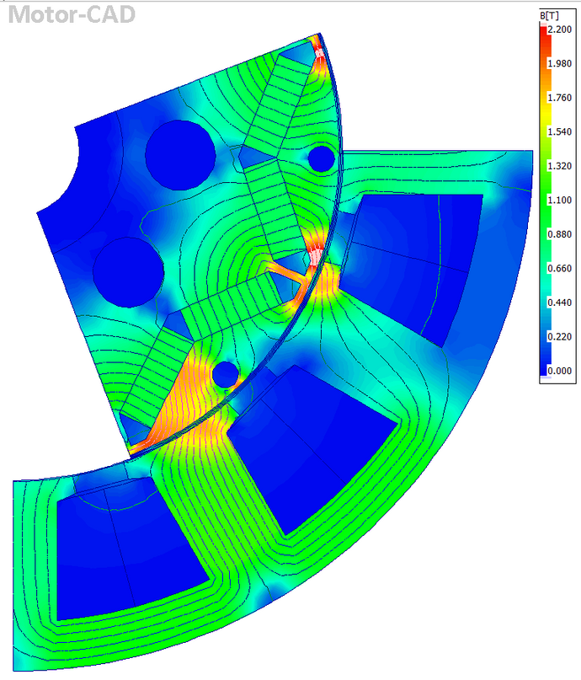
Motor E-Magnetic Performance
Cogging Torque
Dynamic Load Test
Static Load Test
Enabling Mobility Solutions
Strictly Confidential
3

Slide 9
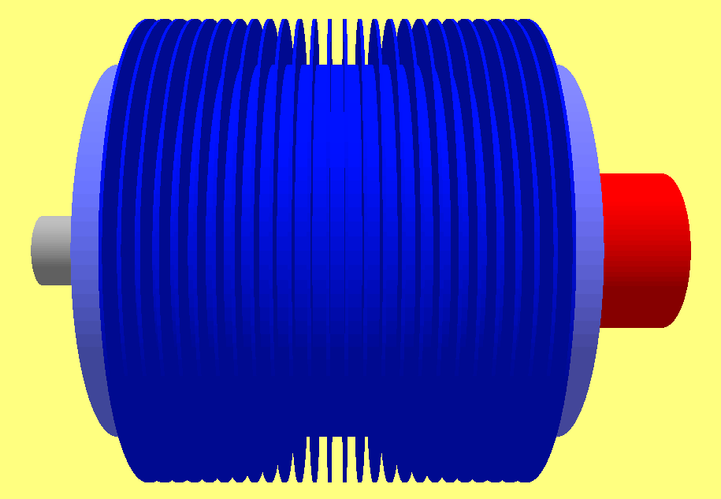
Final Design Parameters
Motor Length = 150mm
Housing Diameter = 130mm
Fin Extension = 15mm
Stator Laminate Diameter = 118mm
Stator Bore Diameter = 75mm
Airgap Length = 0.5mm
Enabling Mobility Solutions
Strictly Confidential
3

Slide 10
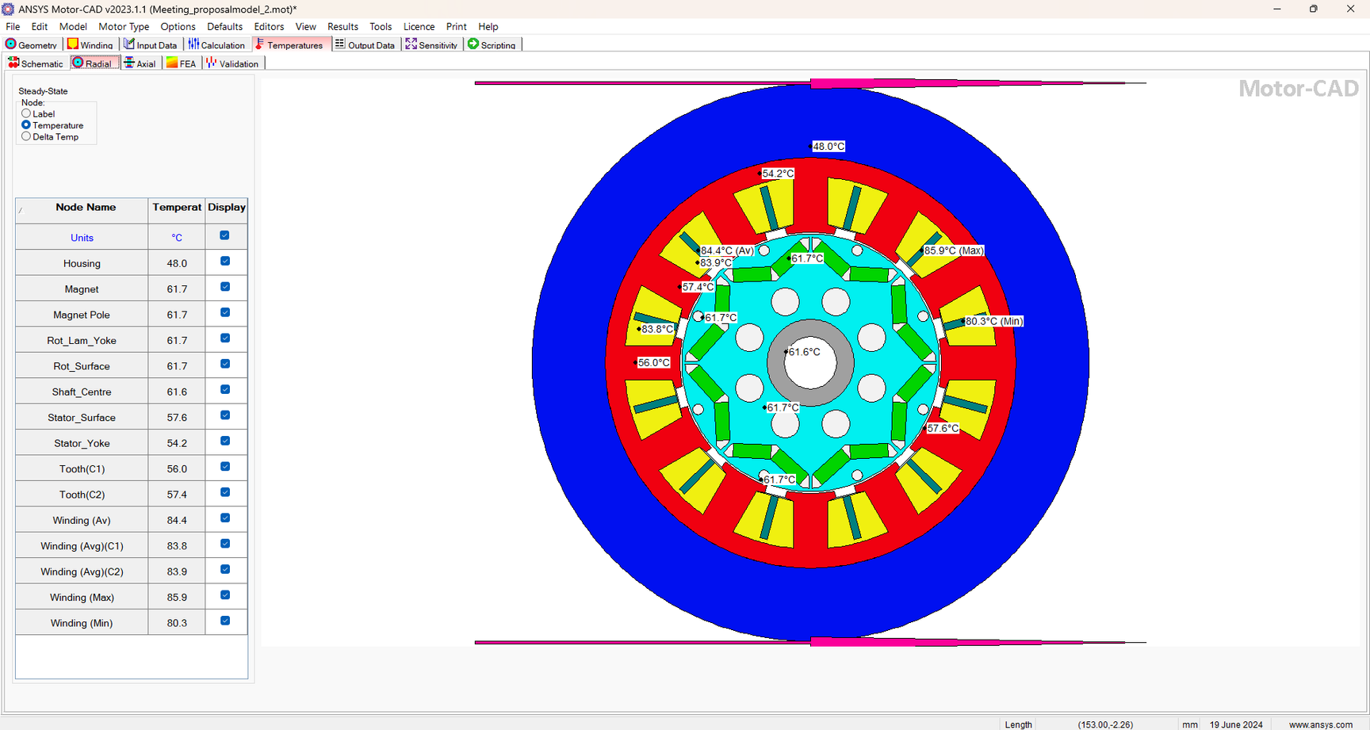
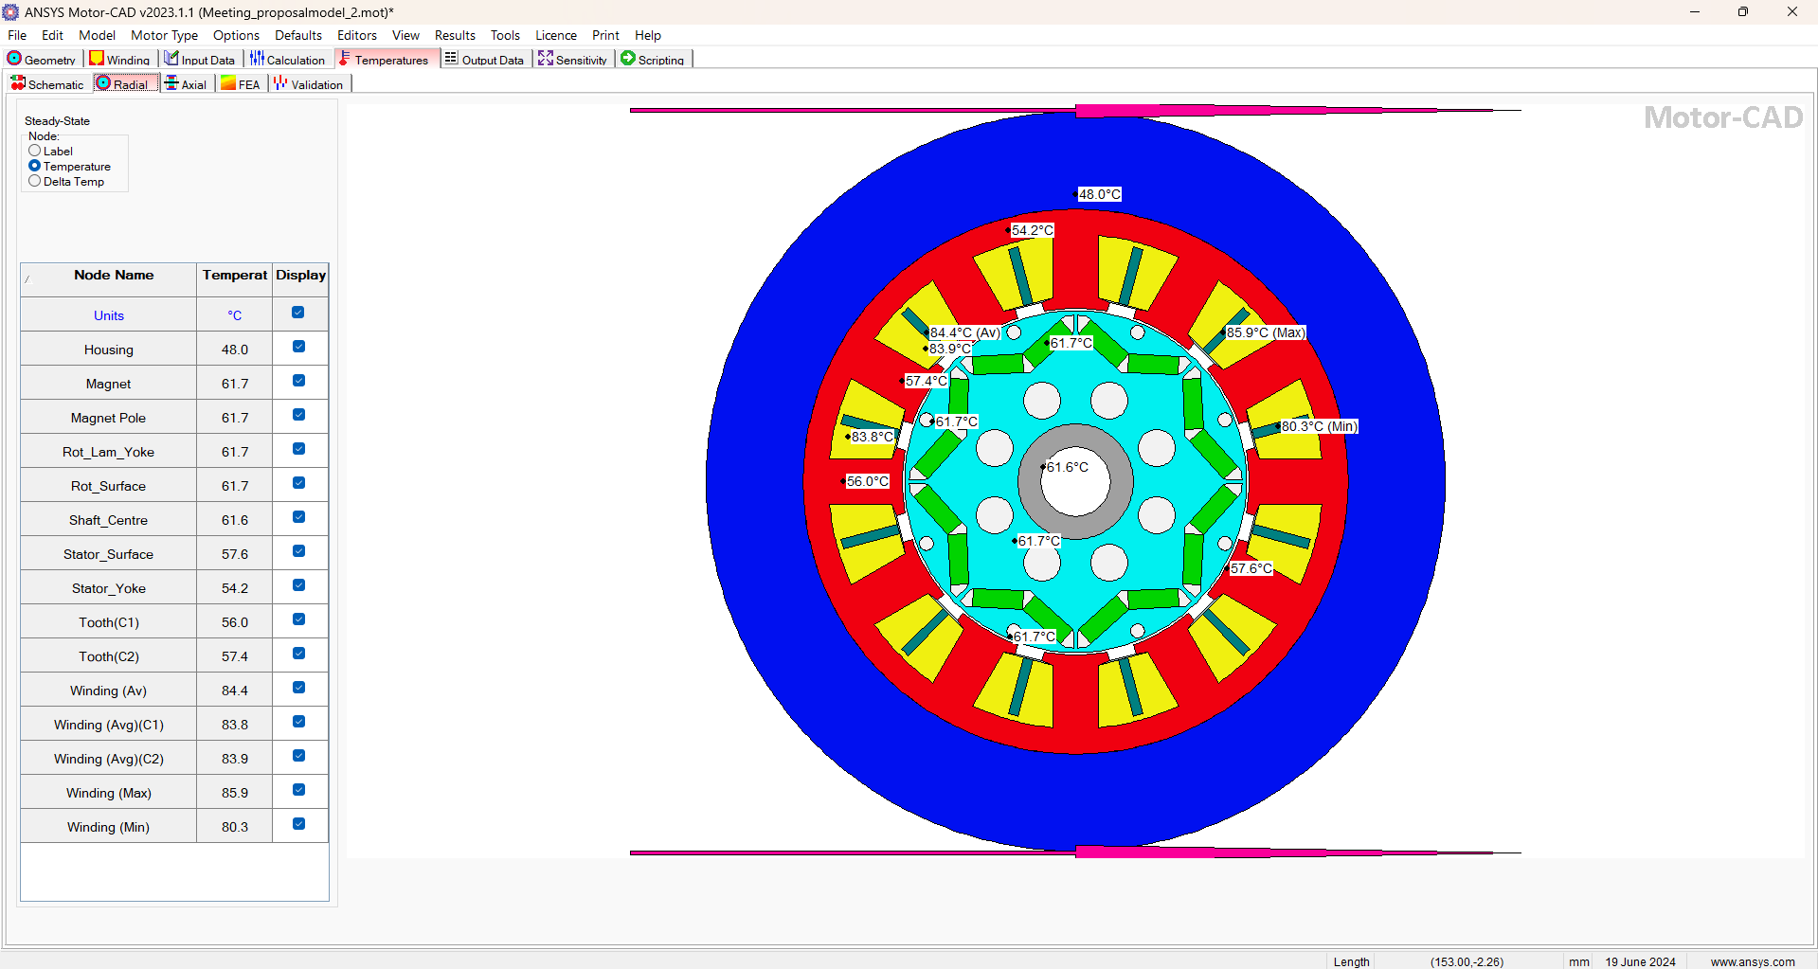
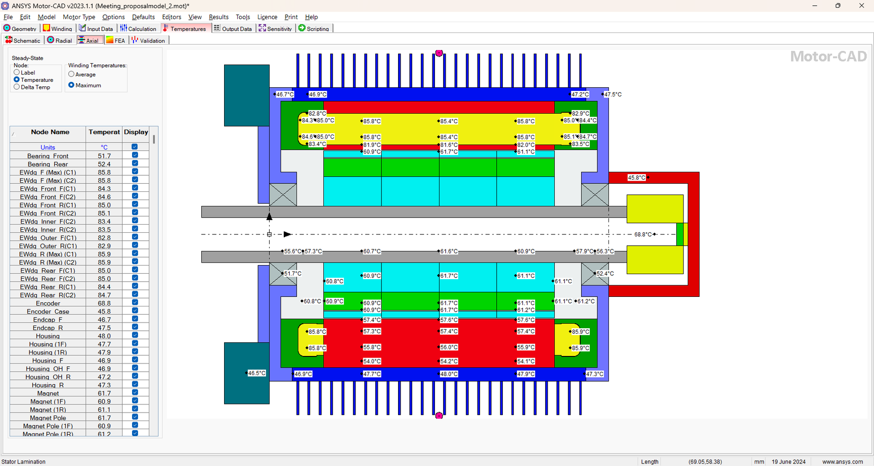
Motor Housing and Thermal Analysis
3D Steady State
Enabling Mobility Solutions
Strictly Confidential
3

Slide 11
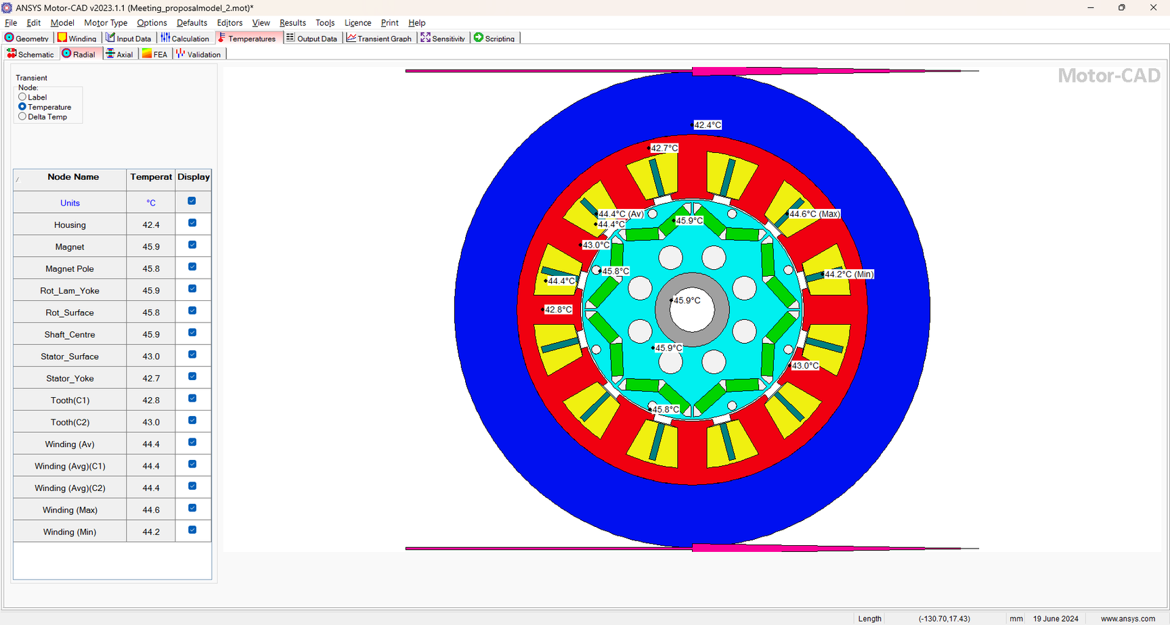


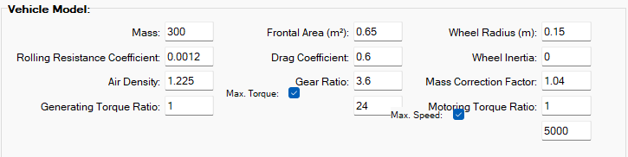
Motor Housing and Thermal Analysis
3D Transient: WLTP-I
Enabling Mobility Solutions
Strictly Confidential
3

Slide 12
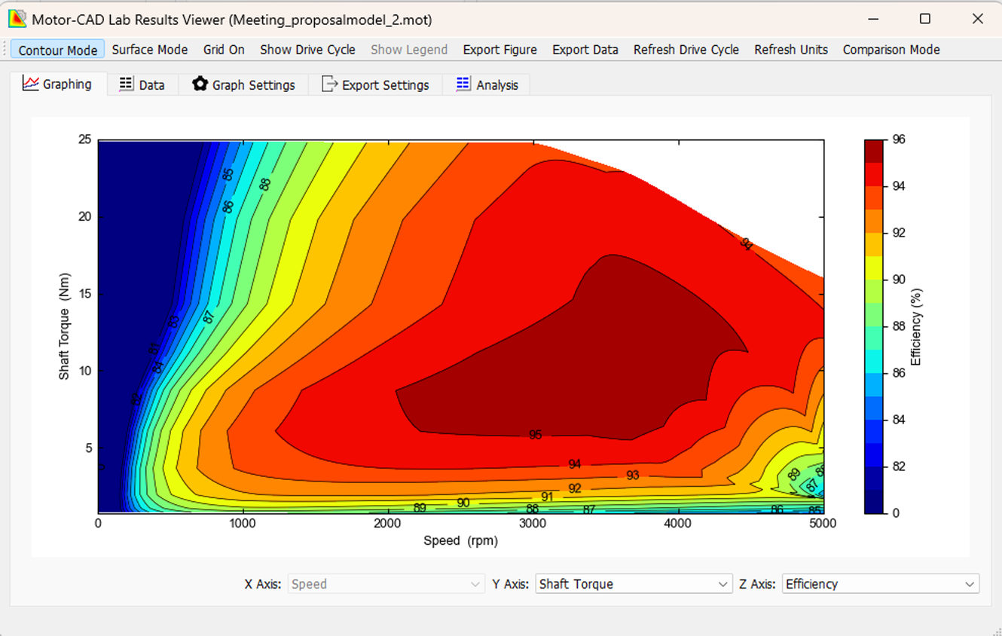
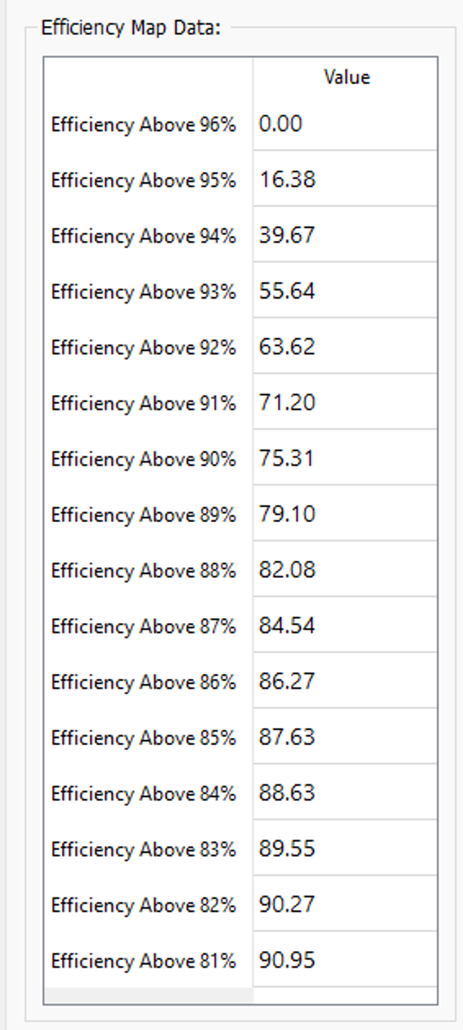
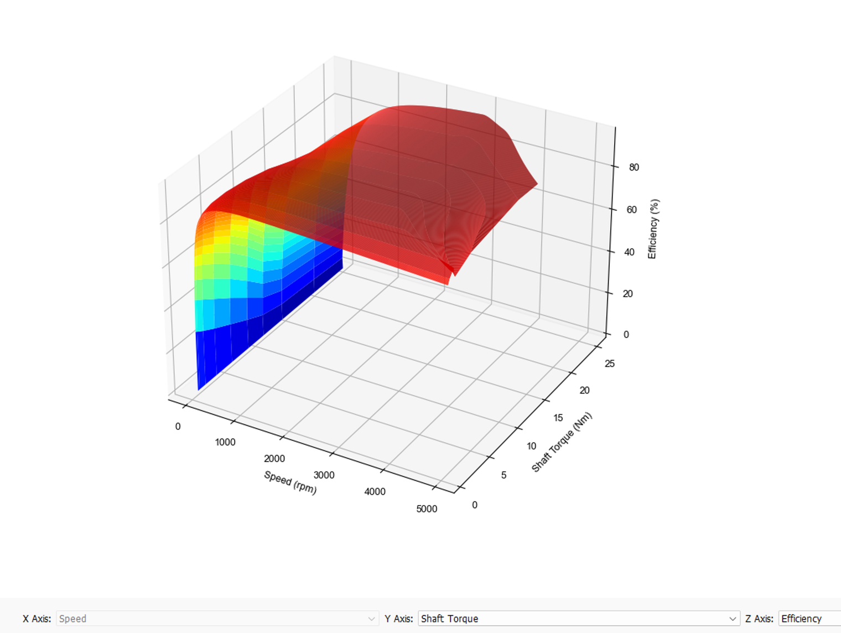
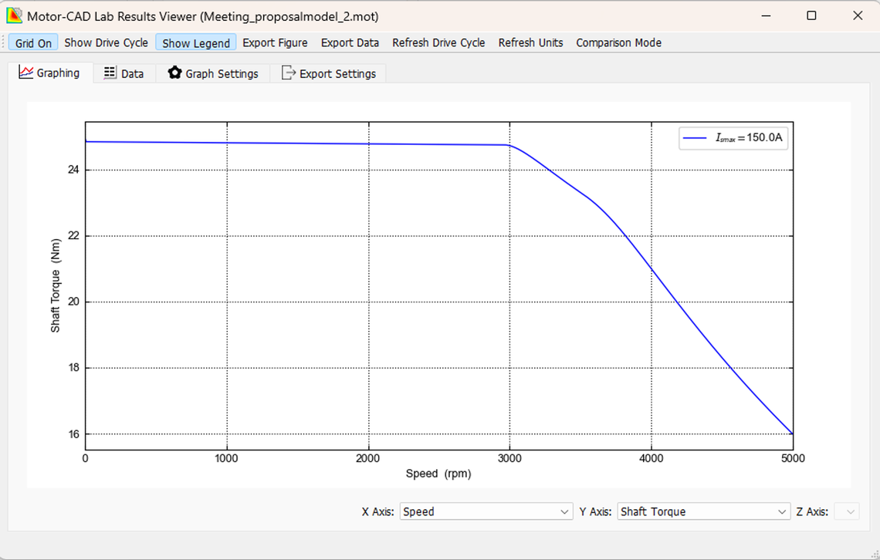
Transient Performance Metrics
Enabling Mobility Solutions
Strictly Confidential
3

Slide 13
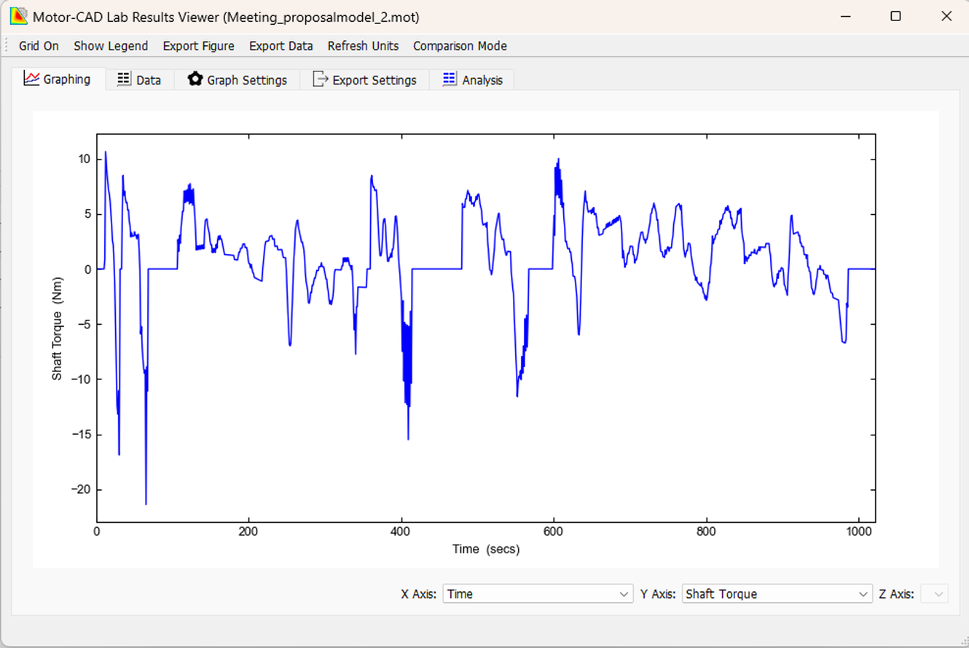
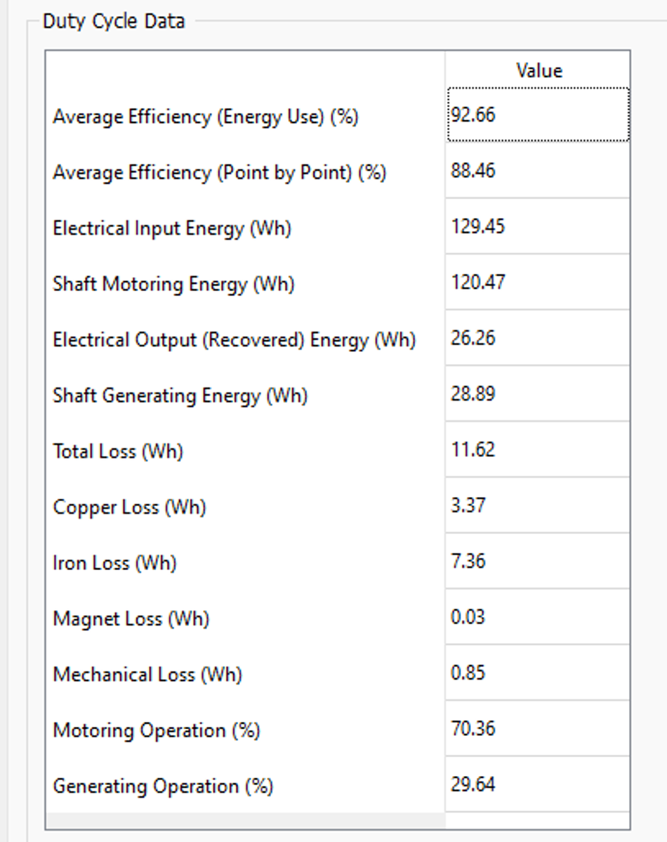
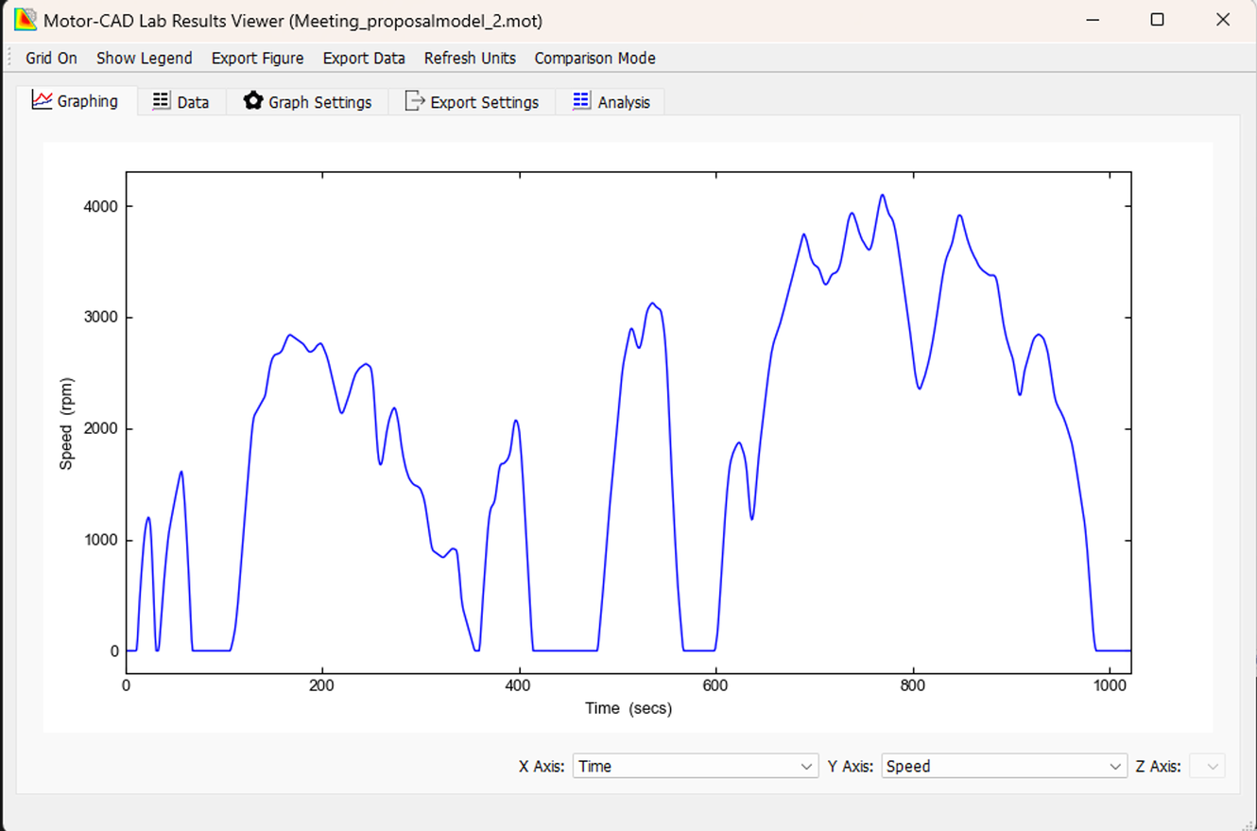
Drive Cycle Mechanical Performance
Enabling Mobility Solutions
Strictly Confidential
3

Slide 14
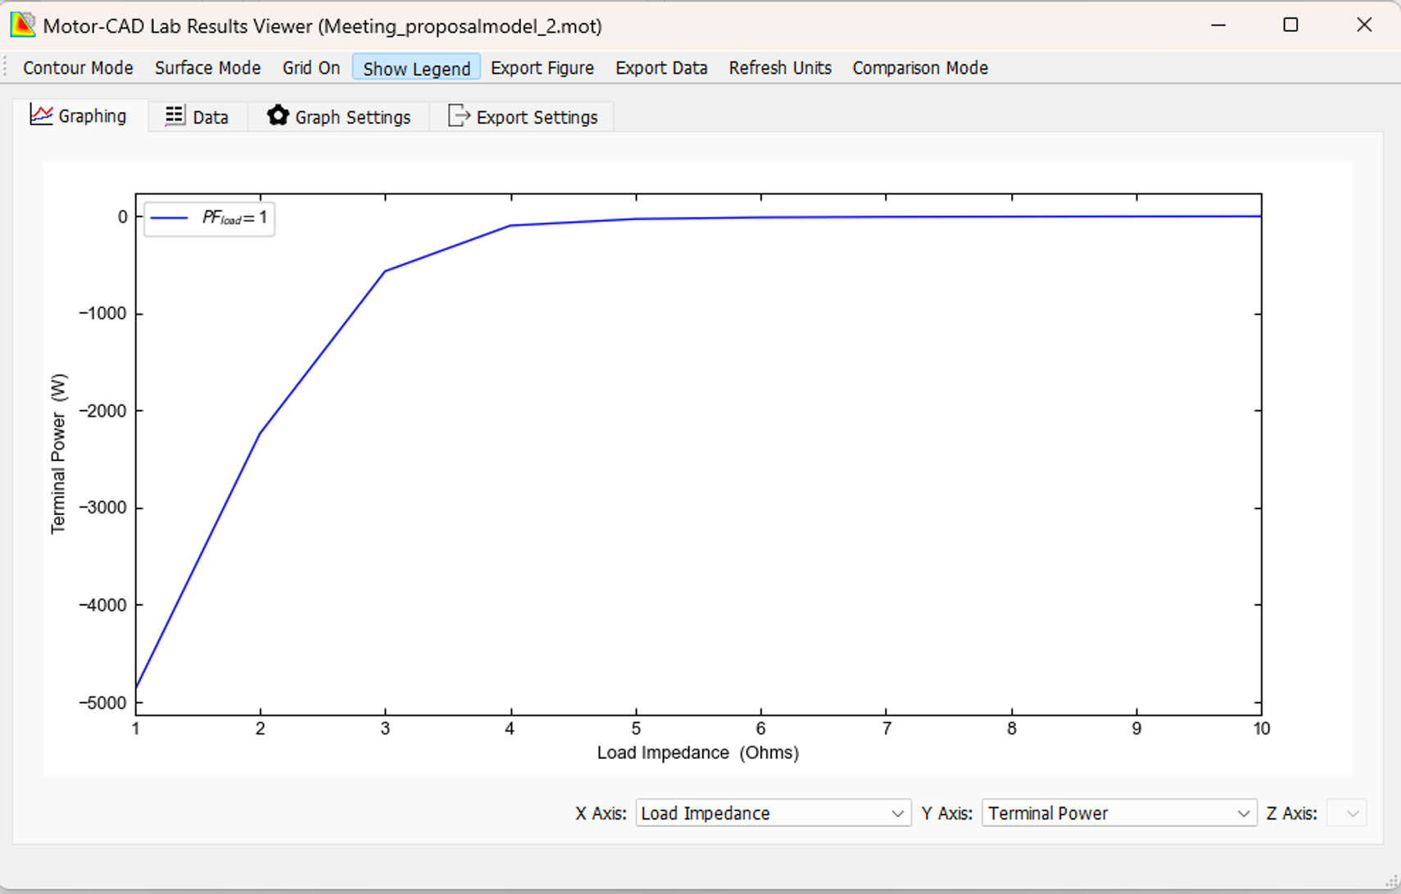
Secondary Performance Characteristics
Enabling Mobility Solutions
Strictly Confidential
3

Slide 15
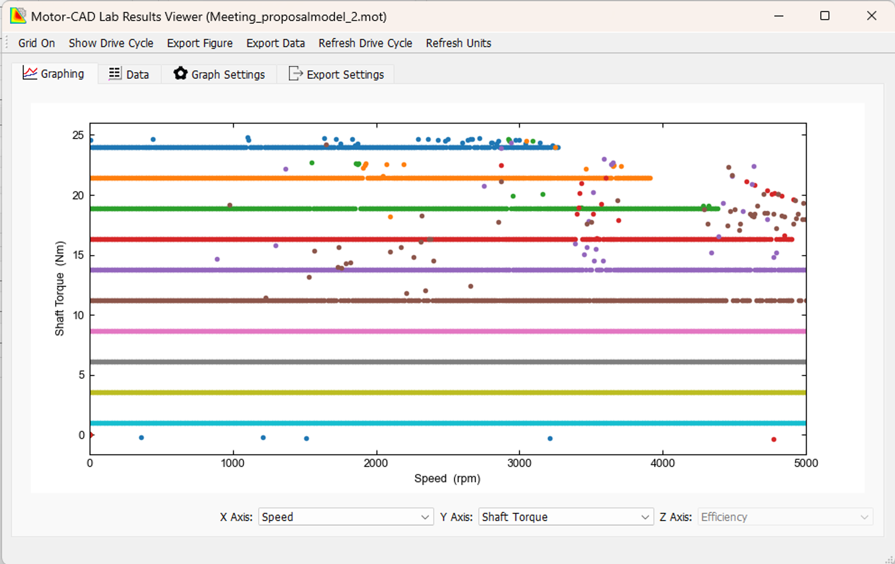
Secondary Performance Characteristics
Torque Grid
Enabling Mobility Solutions
Strictly Confidential
3

Slide 16

Thank You
Enabling Mobility Solutions
Strictly Confidential
6
TACO Prestolite Electric Pvt Ltd

